Slide 1
AUDION GAME ENGINE - CEREAL KILLER GAME
By; Nathan Sainsbury, Wade Garrett, Augustine Obiogbolu

Slide 2
PROJECT MANAGEMENT
Source code management was achieved using GitHub
Each member kept their own copy of the project
Aim to make a large number of small commits
  Less likely to cause errors
  Easier to roll back
  Gives a detailed record of the project’s history

Slide 3
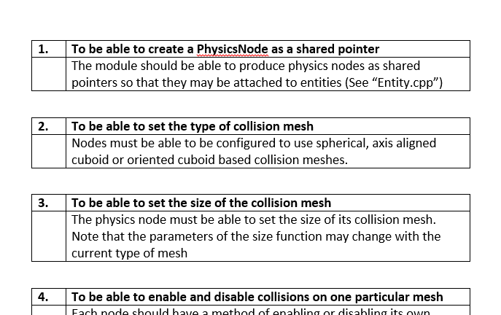
ROLE FULFILMENT
TECHNICAL DIRECTION
  My engine – my responsibility to explain it
  Predicting problems
  Suggesting architecture & functional requirements
  Programming to an interface
  Not stepping on each others toes is difficult
    Especially in smaller projects
Notes:
Using this slide to introduce the idea of being a technical director
Explaining my engine
My engine – my responsibility
Tell them whats important and whats not – no fluff
Things should just “work” – no messing about
Predicting problems
Leading people in the right direction
Knowing the teams strengths and weaknesses
- Hard to do on such a short project
Suggesting architecture
Where requested
Functional spec to focus efforts
Programming to interface
Avoid github and design collisions by programming to expectations rather than what currently exists
Not stepping on toes
Hard
Had some problems with it but were resolved quickly
The accidental upload at the end

Slide 4
ROLE FULFILMENT
GAMEPLAY DEVELOPMENT
Aimed to create a game that was both simple and interesting in design
Decided on a horror/action theme, based in a supermarket
  Designed and acquired assets around this this theme and setting
Brightly coloured objects in a dark environment
  Easy to see
  Cartoony and visually interesting
Cereal Monsters are created from mostly boxes
  Easy to model and animate
Different from other game’s design

Slide 5
ROLE FULFILMENT
PROGRAMMER
Must work to understand the engine's structure, and how my own code will fit into it.
Follow the standards agreed upon by the group.
Listen to the guidelines given by the engine's creator, and make contributions to improve it.
Must ensure that any created code does not interfere or overlap with other's work.
Notes:
For Austin to fill out

Slide 6
ENGINE ARCHITECTURE
LAYERS
  Engine is divided in to 3 conceptual layers
  Argument could be made for more or less layers
    Satisfactory for this project
Notes:
Engine is 3 layers
Could have done more but scope becomes too confusing and rules would need to become stricter
E.G: System becomes “Framework” and “System”

Slide 7
ENGINE ARCHITECTURE
LAYERS
  System
    Core modules
      Framework
      Resource management
      Windowing
Notes:
Functionality that cannot be disabled without causing the engine to be functionally dead.
It doesn’t make sense to not want these components.
Can be disabled for testing purposes however

Slide 8
ENGINE ARCHITECTURE
LAYERS
  Scene
    Potentially optional modules
      Artificial intelligence
      Physics
      GUI
Notes:
Scene layer contains modules you probably want but can optionally disable.
Its not frequent but there are some games that wouldn’t use the GUI or AI

Slide 9
ENGINE ARCHITECTURE
LAYERS
  Scene
    Potentially optional modules
      Artificial intelligence
      Physics
      GUI
Notes:
Scene layer contains modules you probably want but can optionally disable.
Its not frequent but there are some games that wouldn’t use the GUI or AI

Slide 10
ENGINE ARCHITECTURE
LAYERS
  Game
    Entirely optional modules
      Weather effects
      Editor
      Scripting
Notes:
These modules are 100% optional and it wouldn’t be uncommon to disable them
It makes a great deal of sense to disable the editor module for a release version of the game too

Slide 11
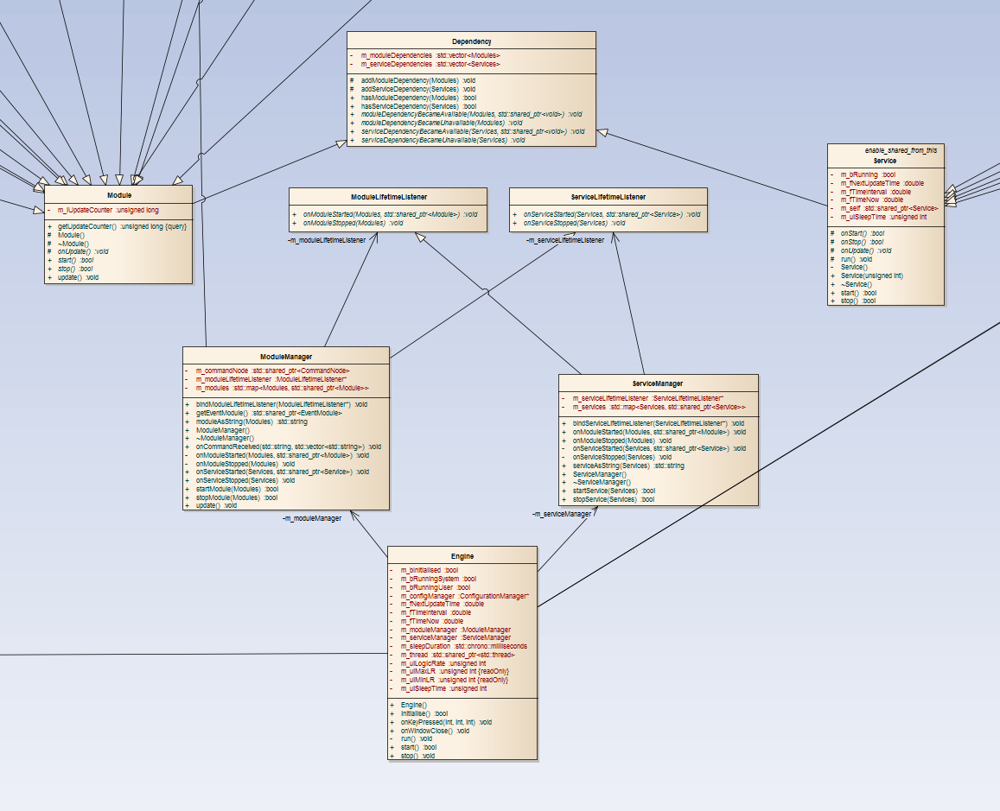
ENGINE ARCHITECTURE
FRAMEWORK
Engine class
Module and Service Managers
Modules and Services
Dependency
Lifetime listeners
Notes:
The engine class is the launch point for the engine
- it contains the game loop
Module and service managers are responsible for storing, starting and stopping modules and services
Modules and services are the base-classes of actual modules and services
Dependency is the means of registering interest in a module or service
Lifetime listeners allow communication between the module and service managers

Slide 12
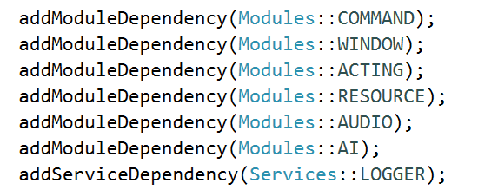
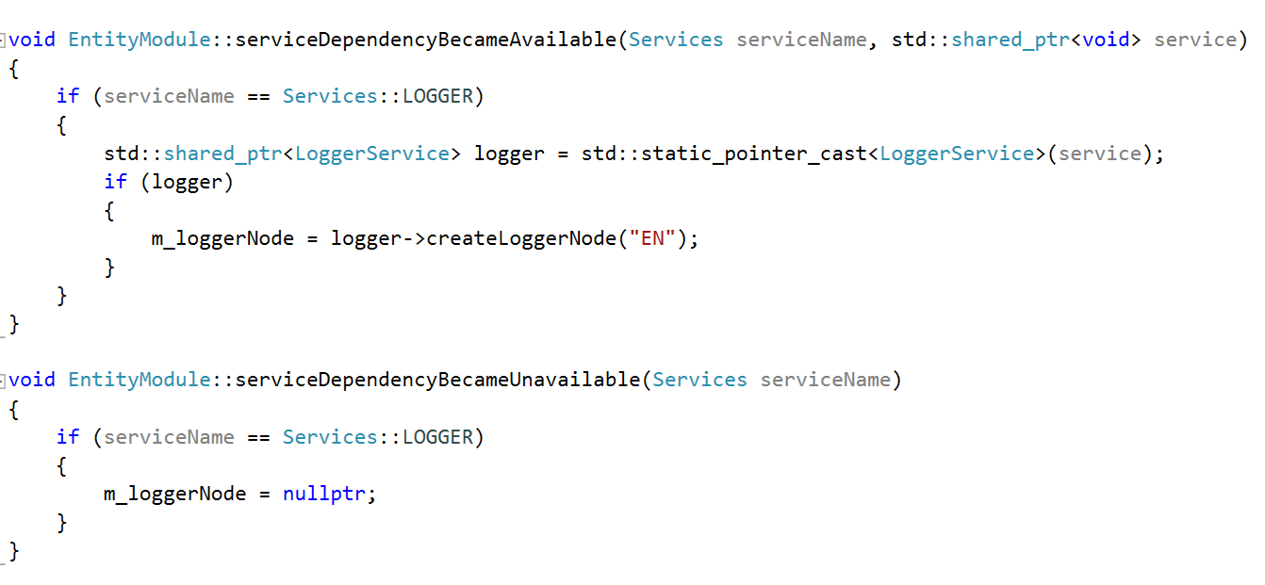
ENGINE ARCHITECTURE
FRAMEWORK
Communications example
Register interest
Capture reference on module/service start-up
Release reference on shut-down
Notes:
The engine class is the launch point for the engine
- it contains the game loop
Module and service managers are responsible for storing, starting and stopping modules and services
Modules and services are the base-classes of actual modules and services
Dependency is the means of registering interest in a module or service
Lifetime listeners allow communication between the module and service managers

Slide 13
ENGINE ARCHITECTURE
MODULES & SERVICES
The building blocks of functionality in the engine
Module
  A collection of related functionality
    Windows
    Input
    Scenes
    Cameras
Service
  A narrow scope of functionality that is capable of running in a separate thread
    Logging

Slide 14
ENGINE ARCHITECTURE
MODULES & SERVICES
Advantages | Disadvantages
Extremely robust | Significant increase in “boilerplate” code to handle individual start-up and shut-down
Easy to isolate point of failure | Difficult to implement significant multithreading optimisations
Easy to work on a module without affecting others’ work | Difficult to implement networking
Many ways to communicate amongst modules without causing circular inheritance
Notes:
Multithreading optimisations usually requires parallel architecture

Slide 15
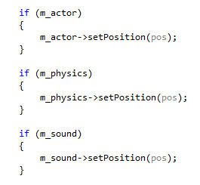
ENGINE ARCHITECTURE
COMPONENTS & INHERITANCE
Polymorphism and inheritance:
  Use for framework but avoid elsewhere
  Avoid RTTI
Component based architecture
  Mainly used to build entities
  Highly configurable
    Entity.attachSoundNode();
    Entity.attachPhysicsNode();
    Entity.attachAINode();
  One check for pointer validity better than setting value on a dormant object
Notes:
Also get to avoid the v-table. Yay!

Slide 16
ENGINE FEATURES
Window & Rendering
Resources
Scenes
Audio
Scripting
Misc
Physics
A.I

Slide 17
FEATURES - PHYSICS
Controlled by the PhysicsModule
  Allows creation and management of Physics Nodes
Each node has a HitRegion
  HitRegions can be Spheres, Axis-Aligned Bounding Boxes or Object Oriented Bounding boxes (rotated)
PhysicsNodes will move and rotate based on their velocity
Collision detected prevents node from moving through each other
CubeGrid design reduces number of collision tests required each frame

Slide 18
FEATURES - AI

Slide 19
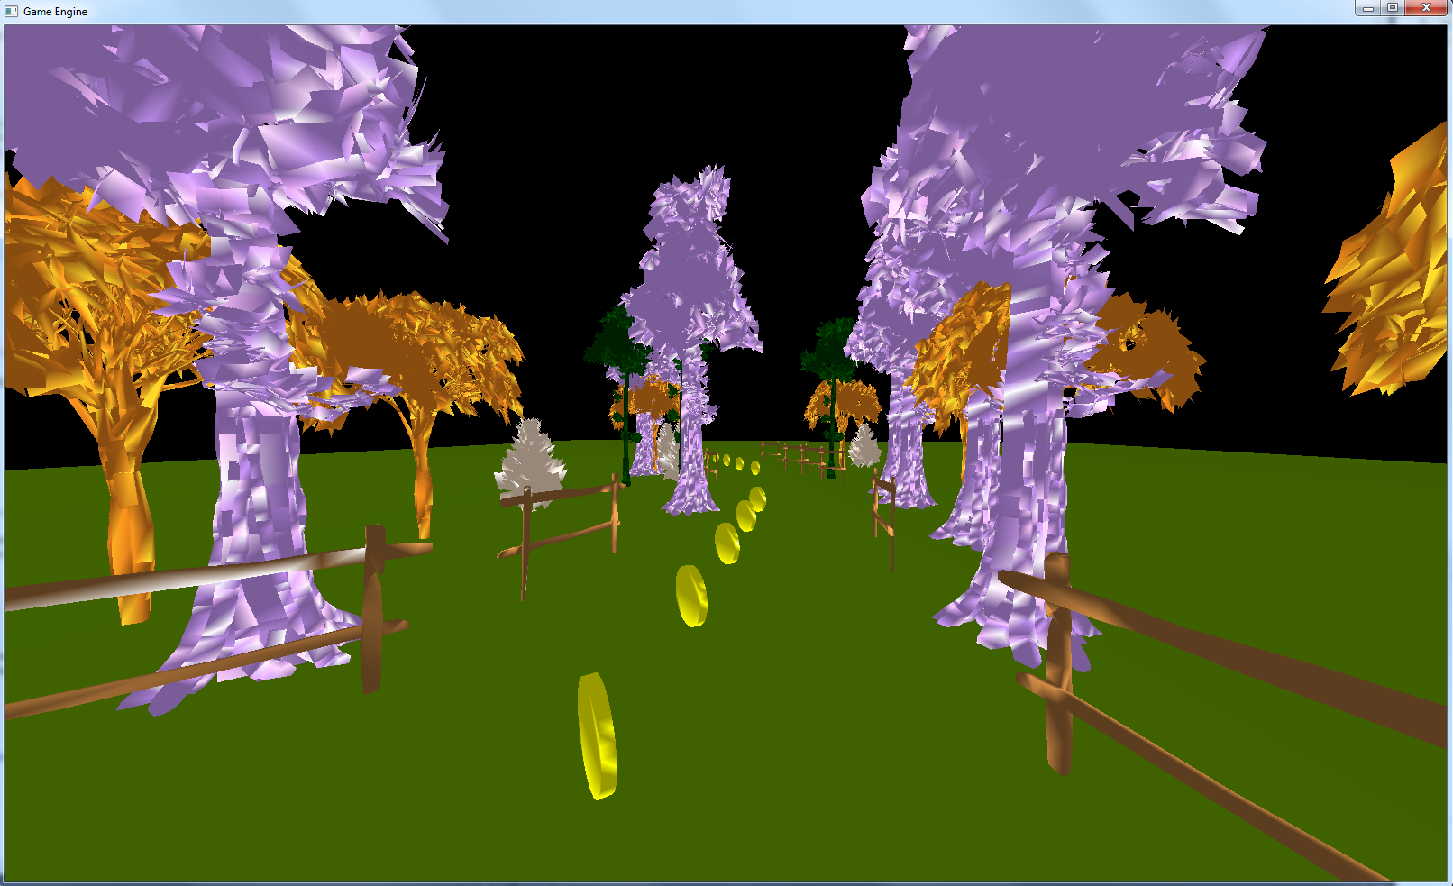
FEATURES – WINDOW & RENDERING

Slide 20
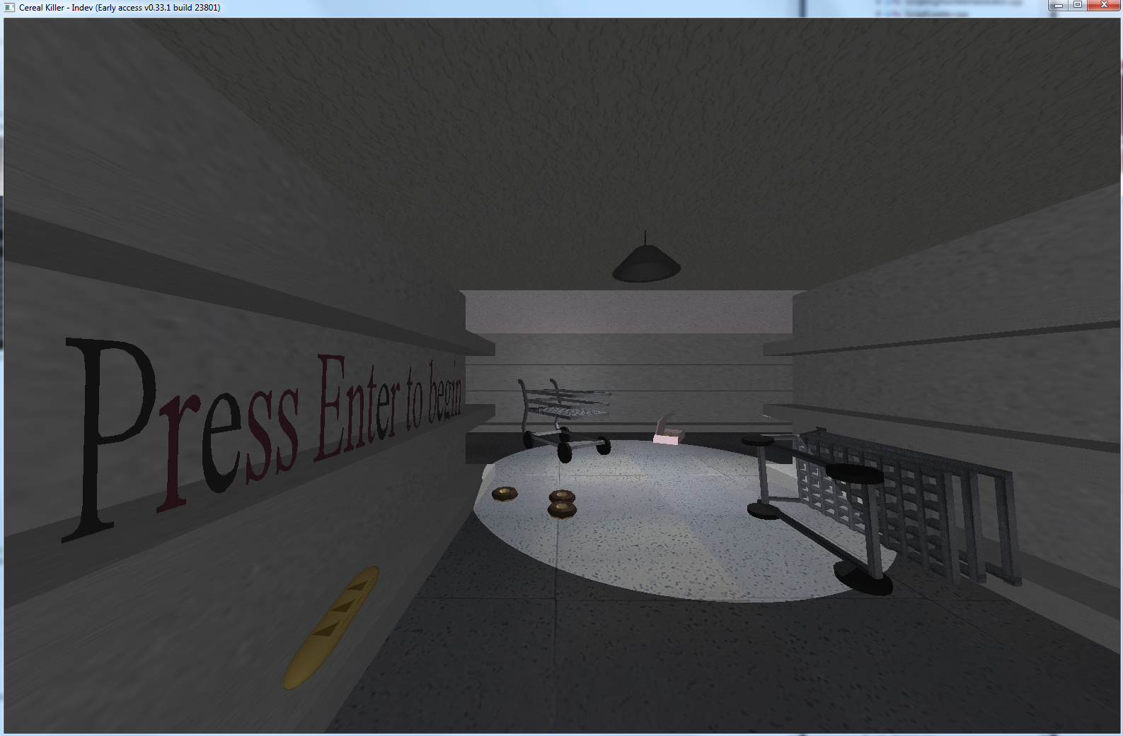
FEATURES – WINDOW & RENDERING

Slide 21
FEATURES – WINDOW & RENDERING

Slide 22
FEATURES – WINDOW & RENDERING
OpenGL shaders for rendering
Can load any numbers of shaders
Supports .obj meshes
Use “actors”
  Links together position, orientation, scale and a pointer to a model
Rendered via entities
Full-screen and windowed borderless supported!

Slide 23
FEATURES – RESOURCES
Resource module
Stores resources in a globally accessible location
Tightly packs data in memory to improve cache hits
Partially templated to avoid dynamic casting
Notes:
Only takes a few changes to add or remove a support resource

Slide 24
FEATURES – SCENES
Scenes support:
  Multiple cameras
    Allows for split screen & mini-map features
  Multiple lights
  One active control set
    Although many can be loaded in to memory
  Up to 20 render-able objects
    Order can be specified

Slide 25
FEATURES - AUDIO
Audio engine
3D sound effects
Background music with optional fade transitions
Divided in to configurable channels for better user interaction
  Modulated by master volume
Uses SFML audio module

Slide 26

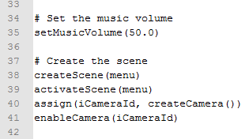
FEATURES - SCRIPTING
A fully functional scripting language
No more hard-coding logic
Limited function set – but extendable
Language supports:
  Magic numbers/strings
  Global variables
  Functions as parameters
  Optional parameters

Slide 27
FEATURES - MISC
Timing module
  Simple creation of and response to timers
Events module
  Global launching and receiving of arbitrary events
Loadable configuration
  Engine configuration loaded from an xml file on launch

Slide 28

THE GAME – CEREAL KILLER

Slide 29
GAME DETAILS
Horror survival game
The player is the Janitor of a cursed supermarket
Trapped inside with hordes of food monsters
Must use whatever he can find to defend himself

Slide 30

CHARCHTERS – THE MONSTER

Slide 31
CHARCHTERS – THE PLAYER

Slide 32
TOOLS USED
GitHub and the GitHub Windows Desktop Client for source code management
Visual Studio 2013 IDE
3D Modelling was done using Maya
  Exported to .MD2 format using a plugin found here: https://github.com/arifken/MD2Export
  Then edited the .MD2 model using FragMotion
Images and textures were created using InkScape

Slide 33
ACKNOWLEDGEMENTS
Music from https://incompetech.com/
Sound effects from https://www.freesound.org

Slide 34
Questions?

